Slide 1

Lecture 4 Parameteric Regression
Abrar Hasan
Lecturer
Dept. of Software Engineering

Slide 2
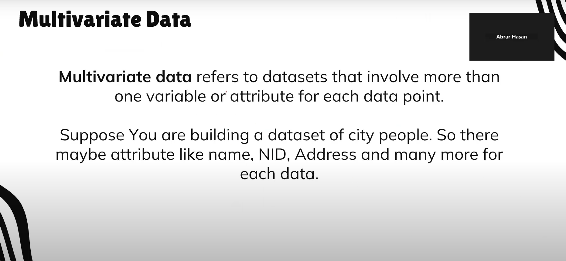
Parametric Regression
<
T
1
>
Parametric regression is a type of regression analysis where we assume that the relationship between the independent variables (predictors) and the dependent variable (target) can be modeled by a specific functional form, typically characterized by a finite set of parameters.

Slide 3
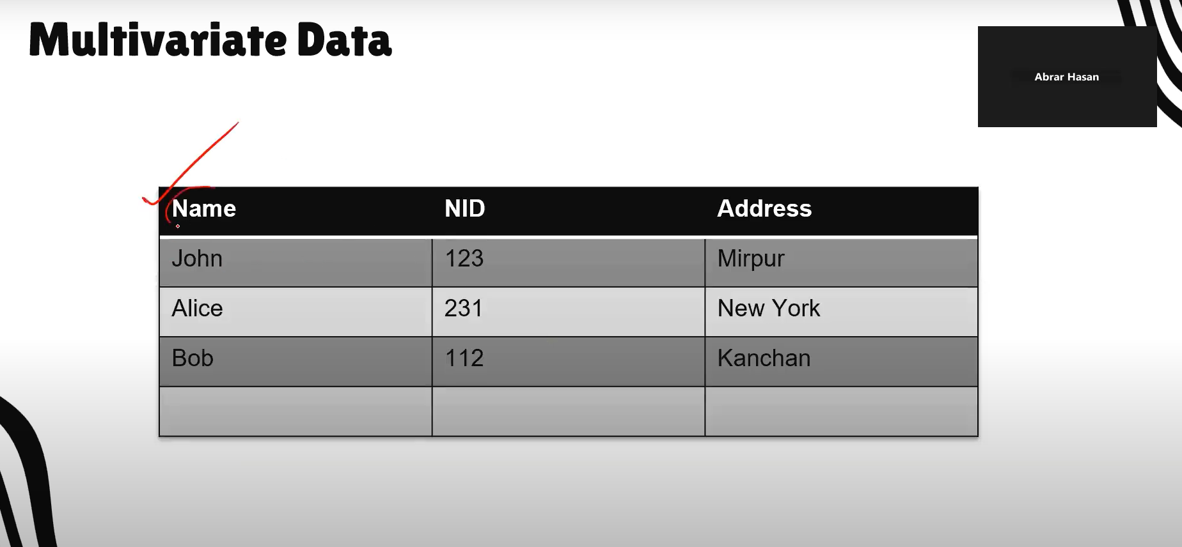
Parametric Regression
<
T
1
>
r = f (x)
e.g, r = mX + c
This can be written as
r = θ * X + c

Slide 4
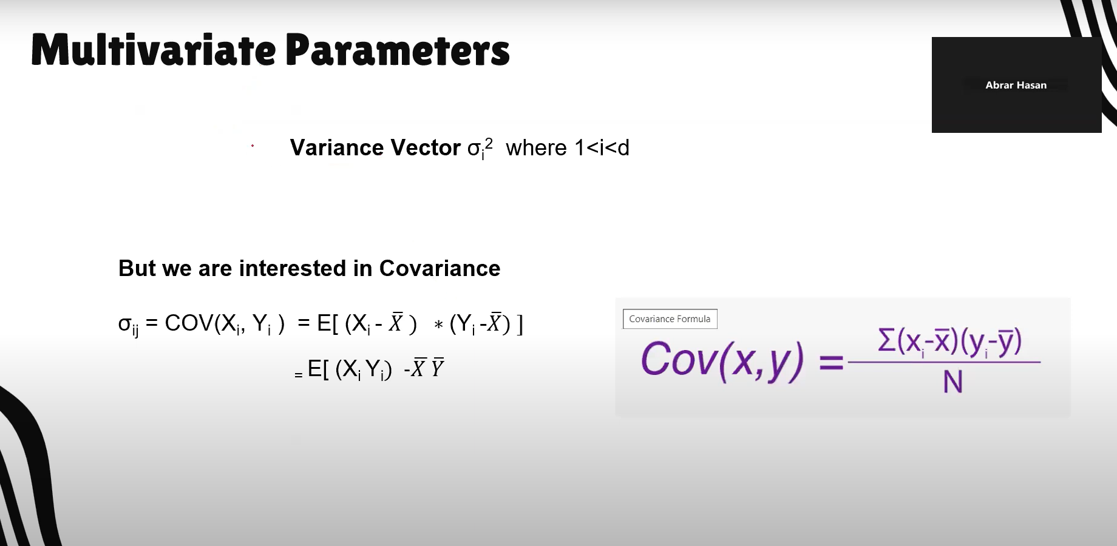
Parametric Regression
<
T
1
>
θ * X + c Can be written as g(x| θ)

Slide 5
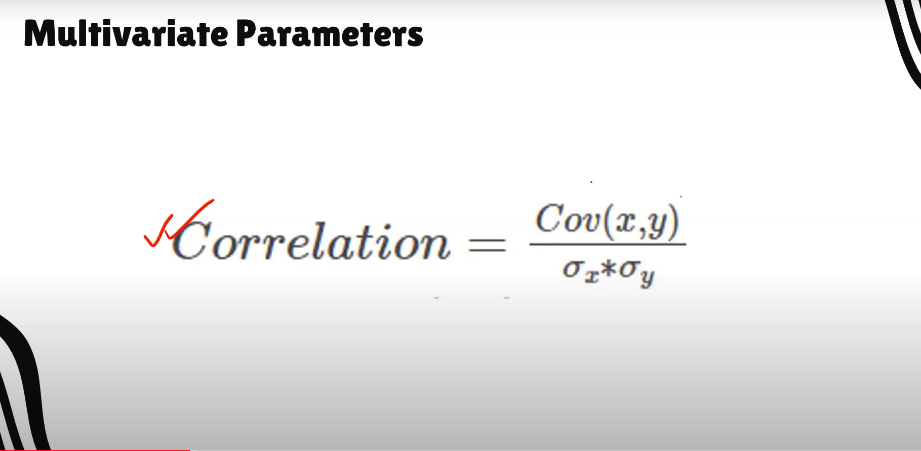
Parametric Regression
<
T
1
>
r = f (x) + ϵ
If we assume the noise to be gaussian, then we can model this Like a normal distribution with mean 0 with variance sigma²
ϵ ∼ N (0, σ²)

Slide 6
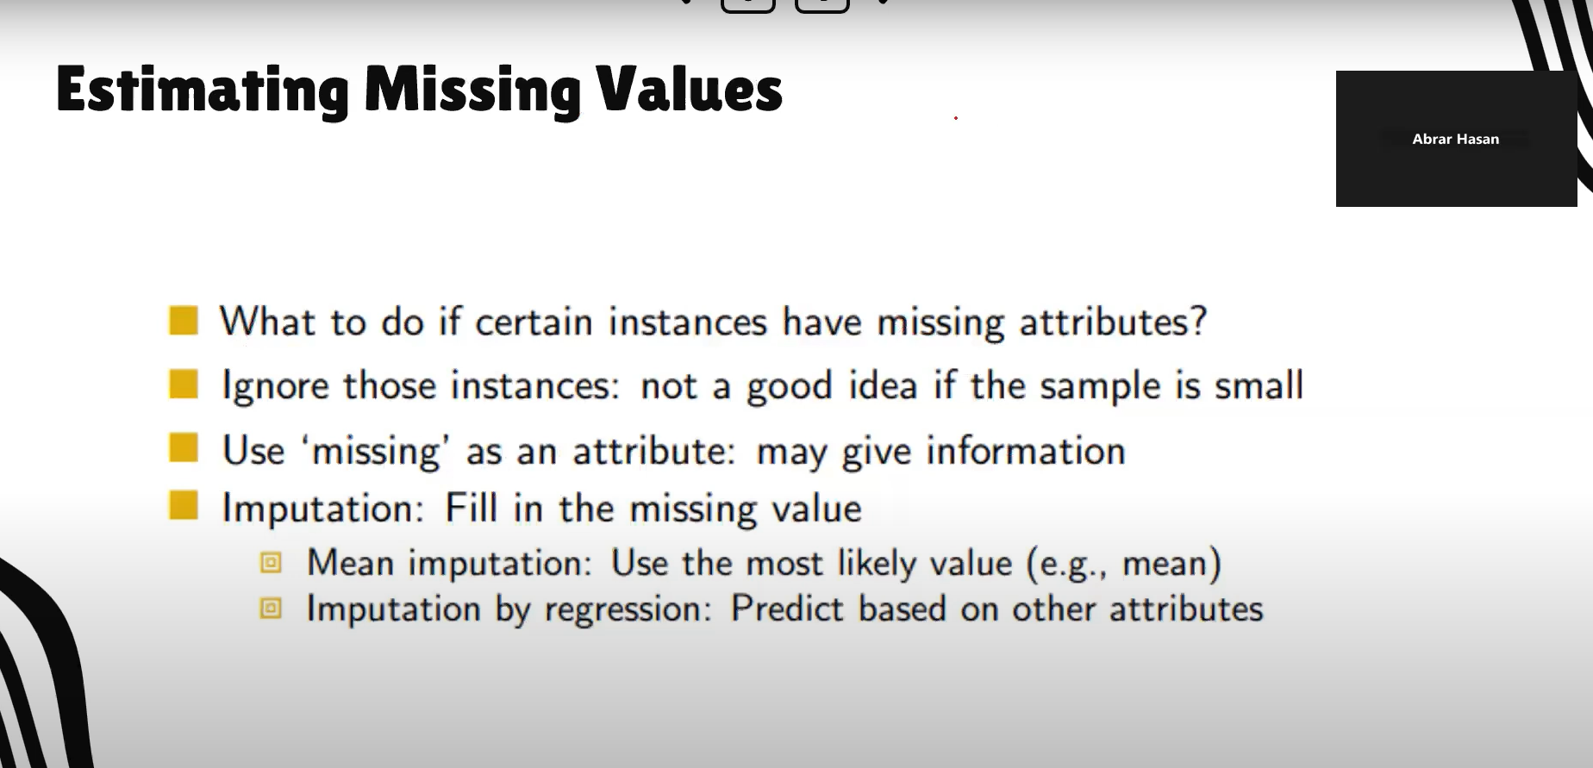
Parametric Regression
<
T
1
>
So the probability of Getting r from input X is
p(r∣x) ∼ N (g(x∣θ), σ²)

Slide 7
Thank You

